Slide 1


Presented By Hrushikesh Shinde
IMDB MOVIES ANALYSIS IN SQL PROJECT

Slide 2

overview
Imdb movie analysis involves examining key factors such as ratings, genres, release years, actors, directors, budgets, and user reviews to identify patterns in the film industry. It explores trends in average ratings, genre popularity, and movie releases over time, as well as the impact of star power, collaborations, and budgets on both ratings and box office performance. Additionally, sentiment analysis of user reviews helps gauge audience perceptions, while comparing domestic and international reception provides insights into global appeal. Awards and recognition also play a significant role in influencing movie ratings and overall popularity.

Slide 3

-: Key Data and Insights :-
Movies url
Title
Poster
Release year
Length in min
Imdb rating
Rating count
Plot
Directors
Writers
Stars
Generes

Slide 4
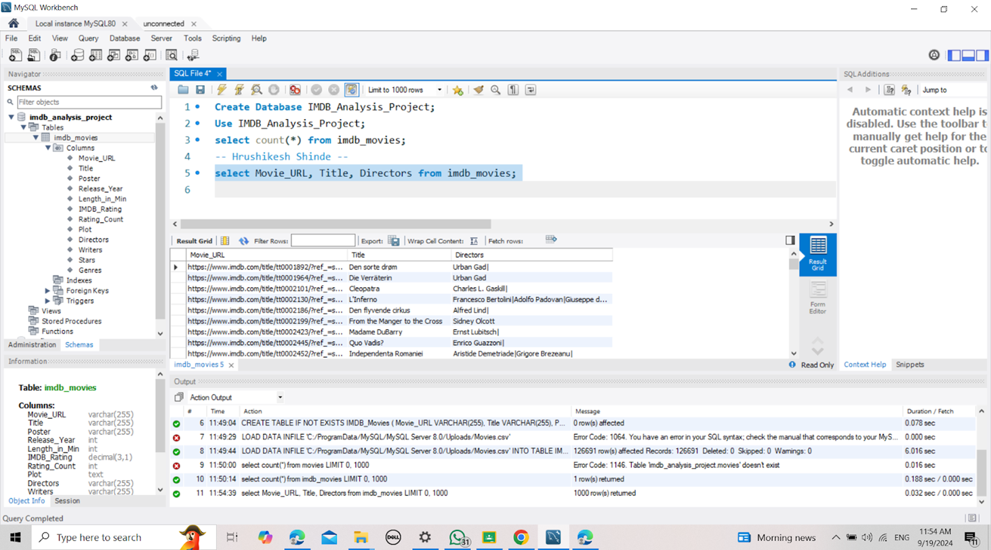
1.List all Movies with URLs,Titles, and Directors
Solution:-select Movie_URL, Title, Directors from imdb_movies;

Slide 5
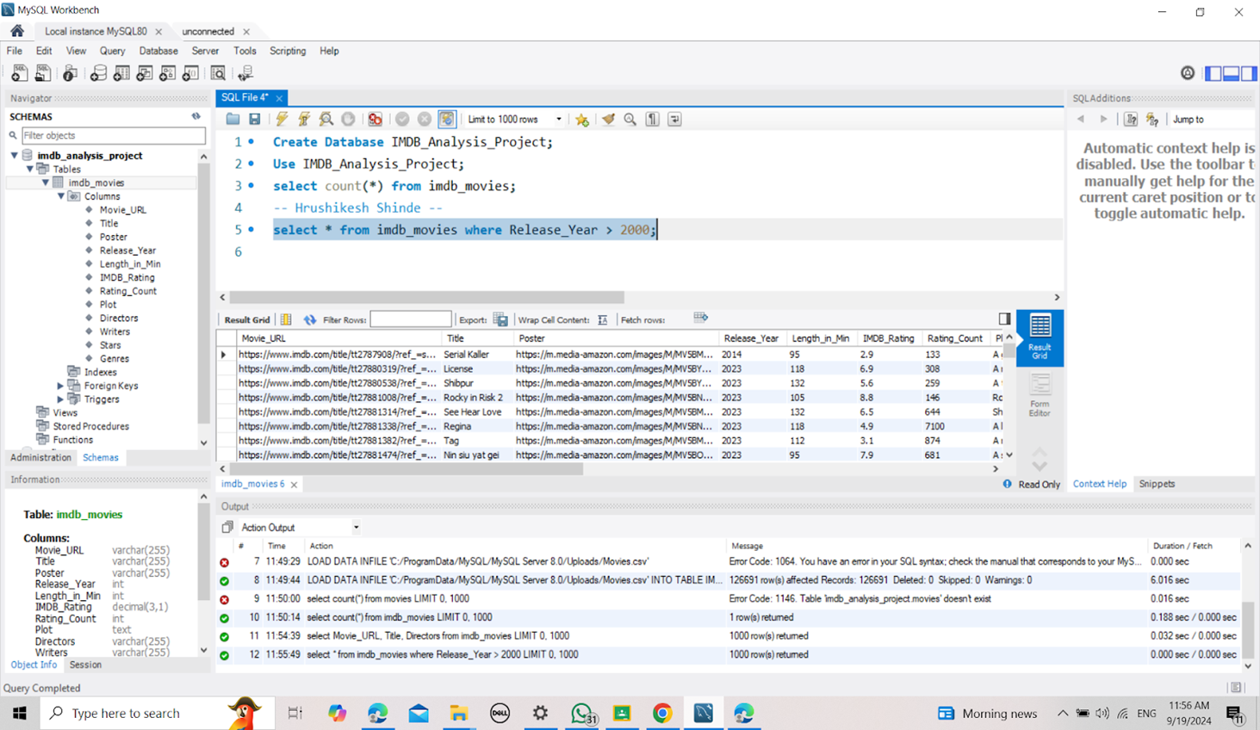

2.Display All columns for movies released after the year 2000.

Slide 6
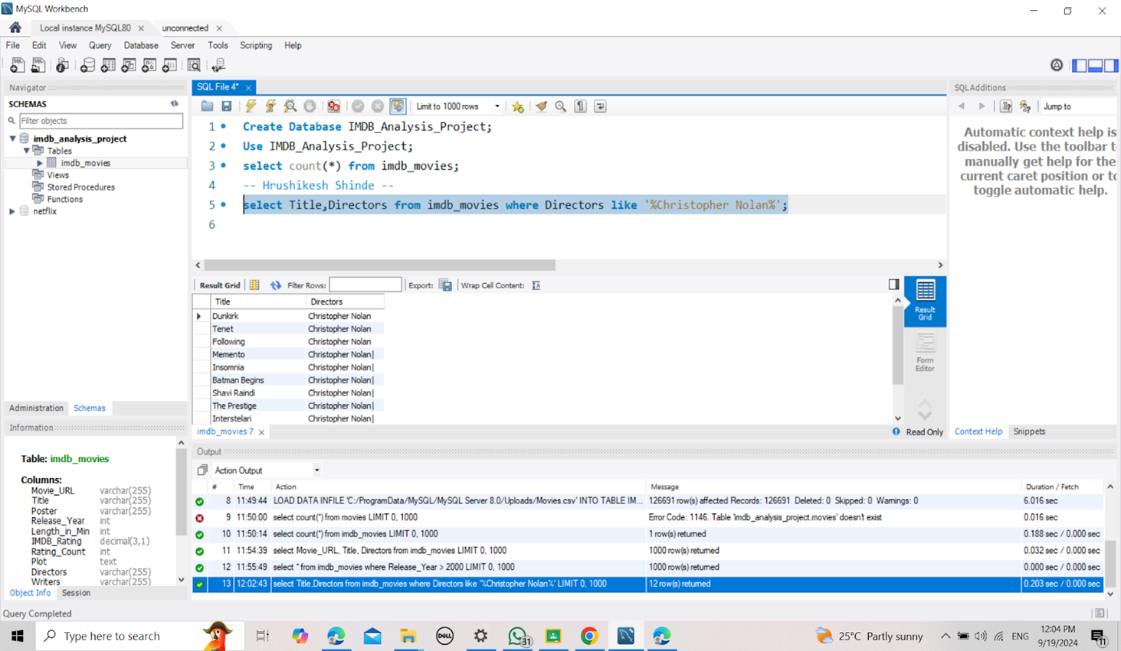
3. List Movies that have Christopher Nolan as one of the directors.
Solution:- select Title,Directors from imdb_movies where Directors like '%Christopher Nolan%';

Slide 7
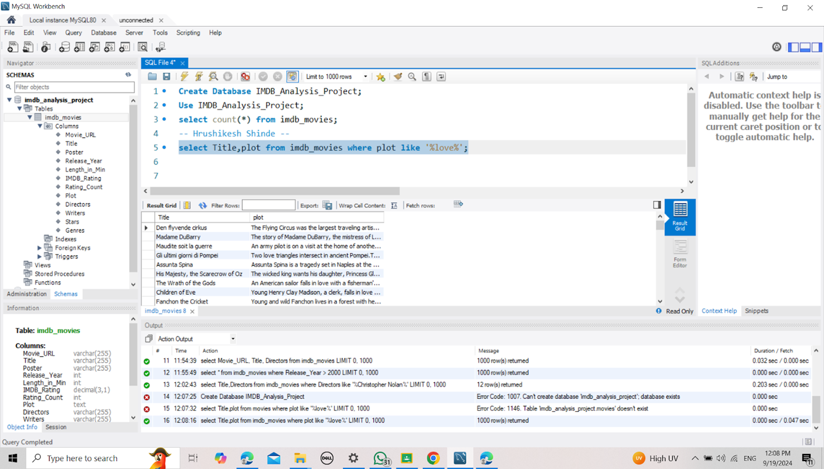
4. Find all Movies where the Plot contains the word LOVE.
Solution:- select Title,plot from imdb_movies where plot like '%love%';

Slide 8
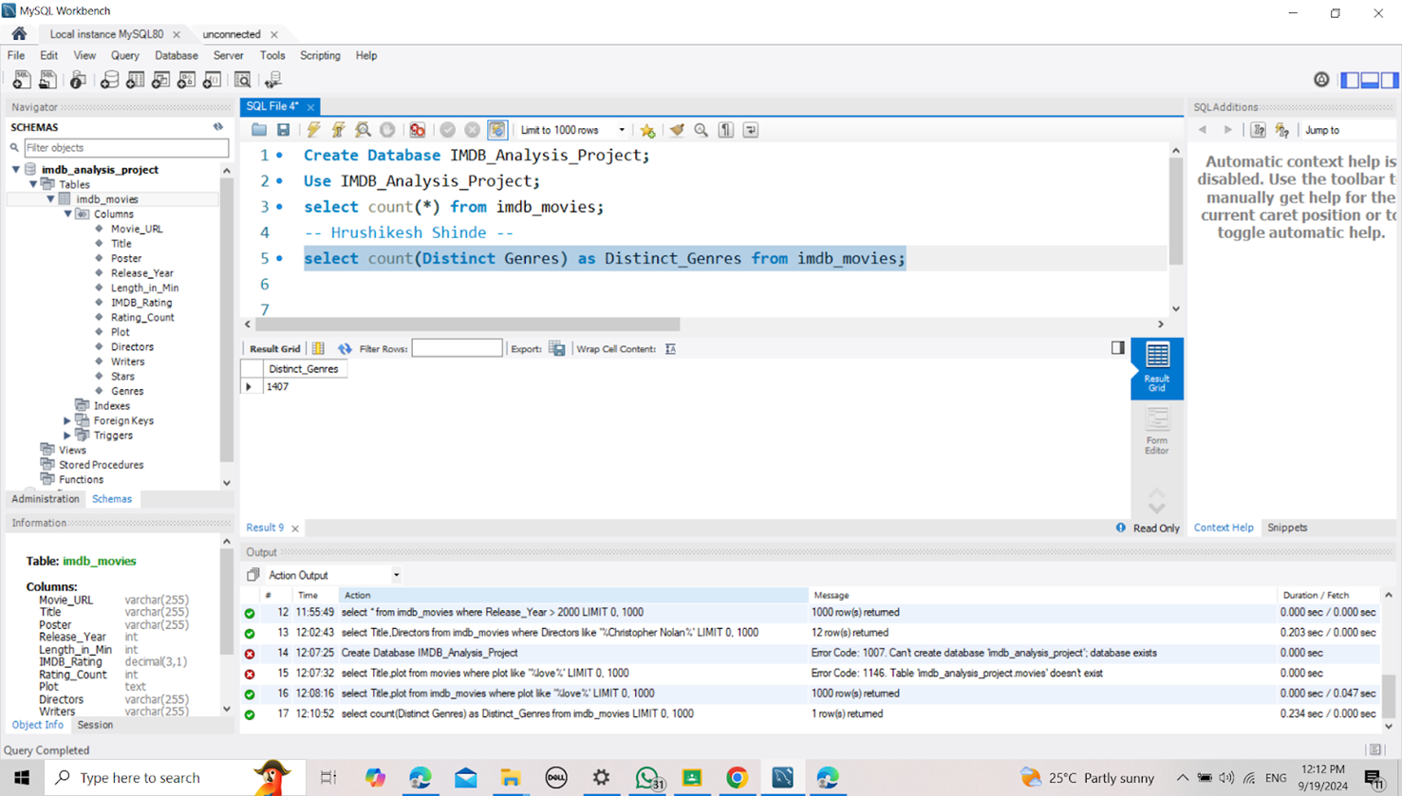
5. Count the Total number of Distinct genres in the dataset.
Solution:- select count(Distinct Genres) as Distinct_Genres from imdb_movies;

Slide 9
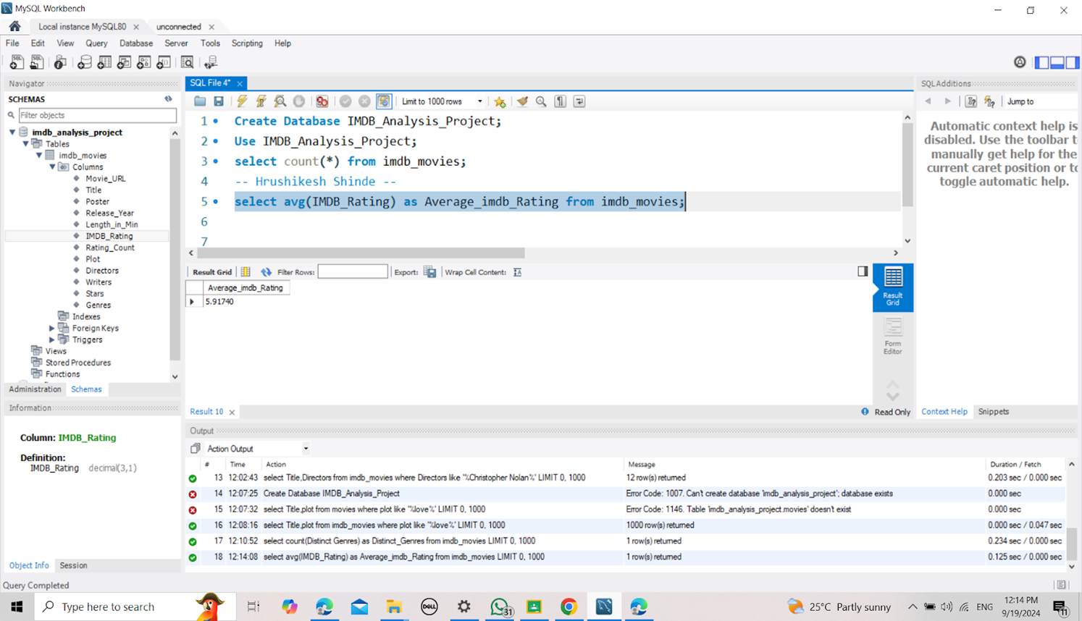
6. Find the Average IMDB Rating of all movies.
Solution:- select avg(IMDB_Rating) as Average_imdb_Rating from imdb_movies;

Slide 10
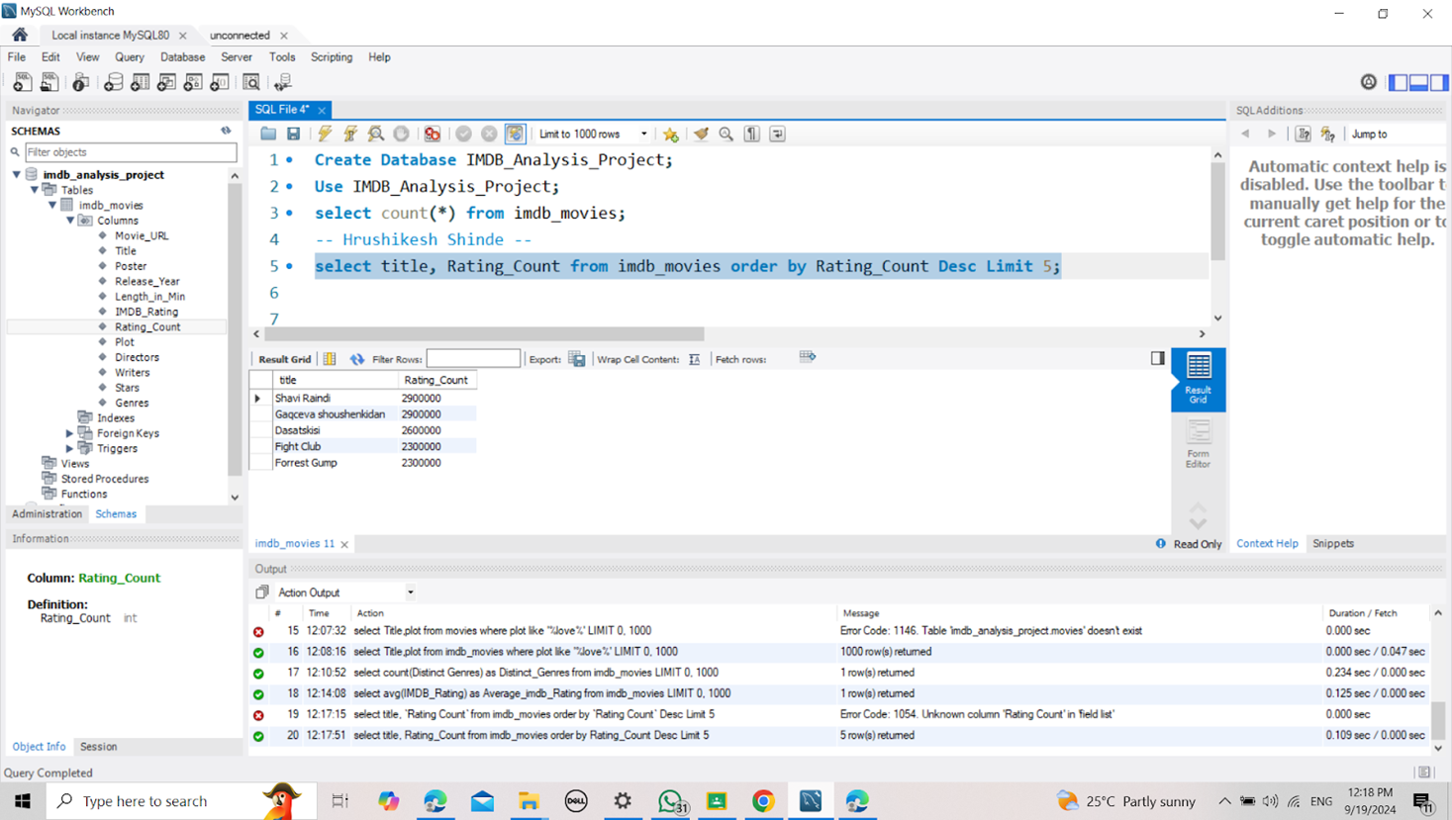
7. List the top 5 movies with the highest Rating count,sorted in descending order.
Solution:- select title, Rating_Count from imdb_movies order by Rating_Count Desc
Limit 5;

Slide 11
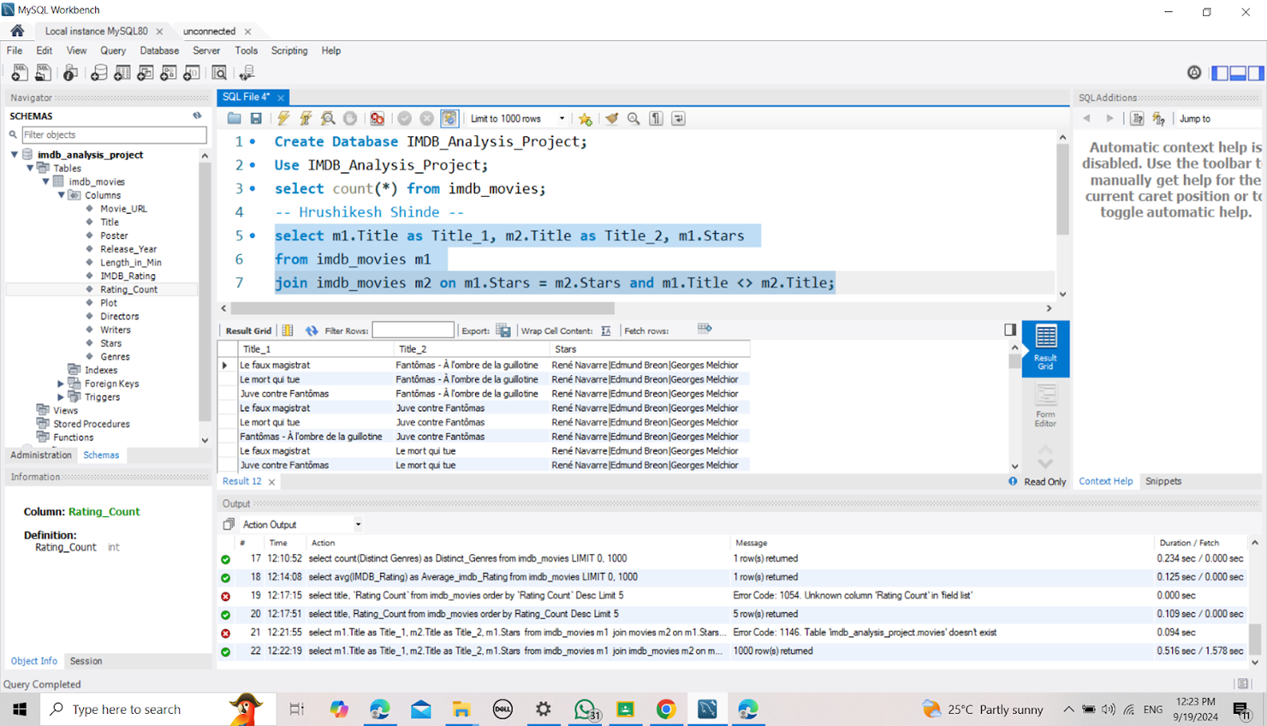
8. List all pairs of movies that share at least one common star. Include columns for title_1, title_2, and stars.
Solution:- select m1.Title as Title_1, m2.Title as Title_2, m1.Stars
from imdb_movies m1
join imdb_movies m2 on m1.Stars = m2.Stars and m1.Title <> m2.Title;

Slide 12
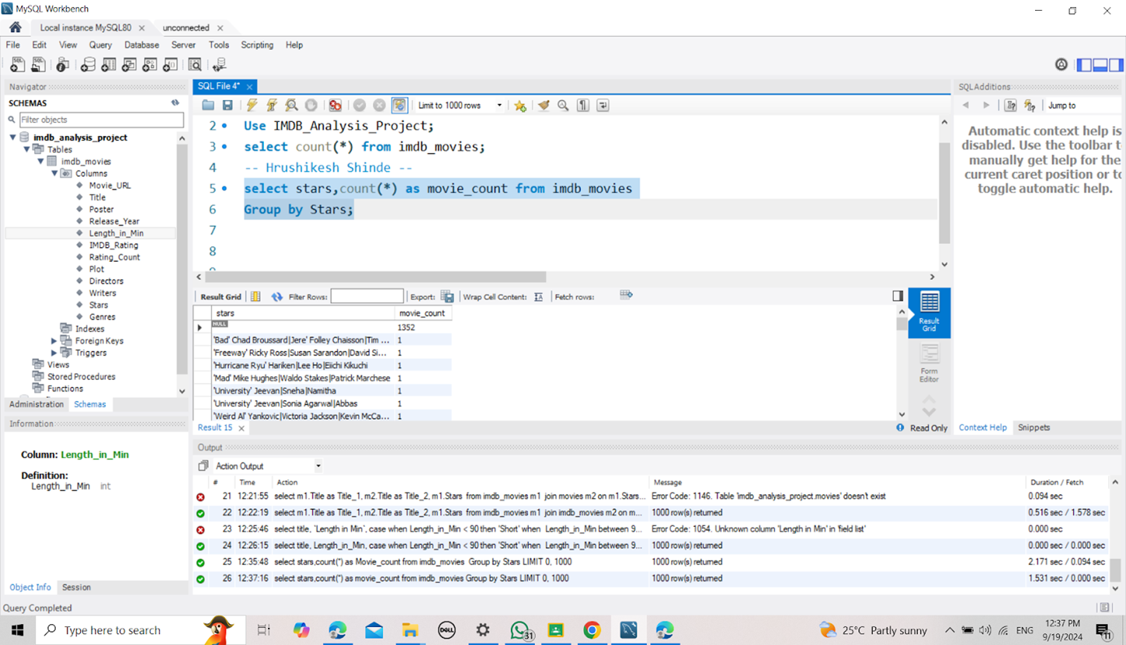
9. Find the total number of movies each star has acted in. Display stars and the count of movies.
Solution:-select stars,count(*) as movie_count from imdb_movies
Group by Stars;

Slide 13
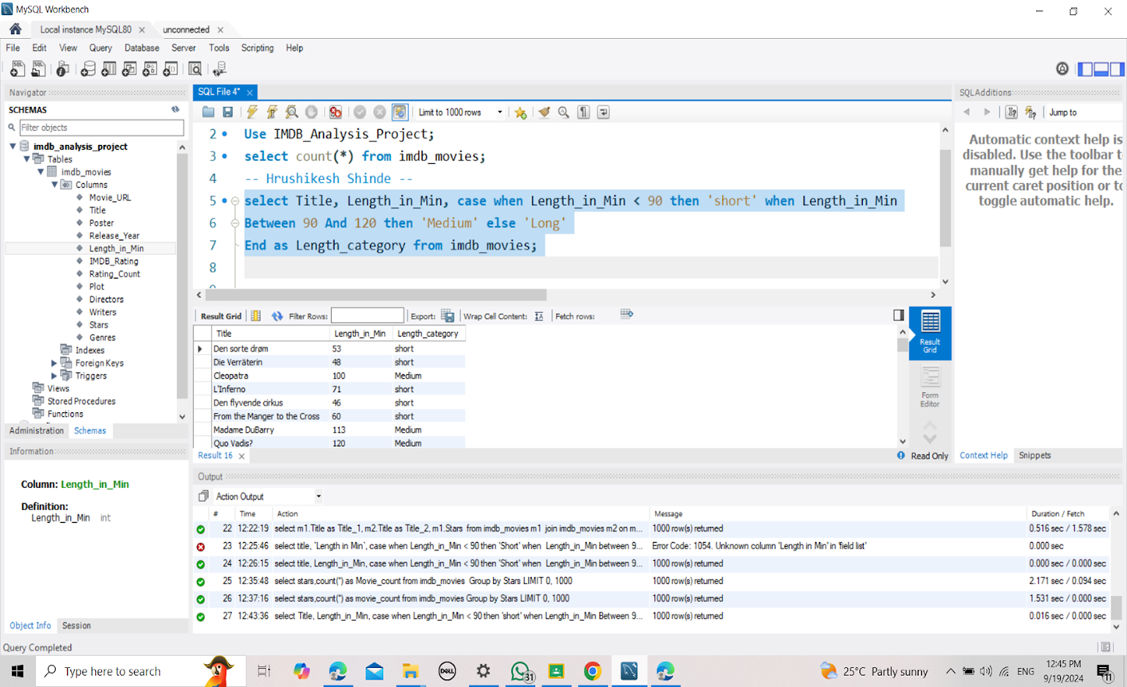
10. Using a CASE statement to categorize movies into three categories based on their length: short for lengths less than 90 minutes, medium for lengths between 90 and 120 minutes, and long for lengths more than 120 minutes.
Solution:-select Title, Length_in_Min, case when Length_in_Min < 90 then 'short' when Length_in_Min
Between 90 And 120 then 'Medium' else 'Long’
End as Length_category from imdb_movies;

Slide 14
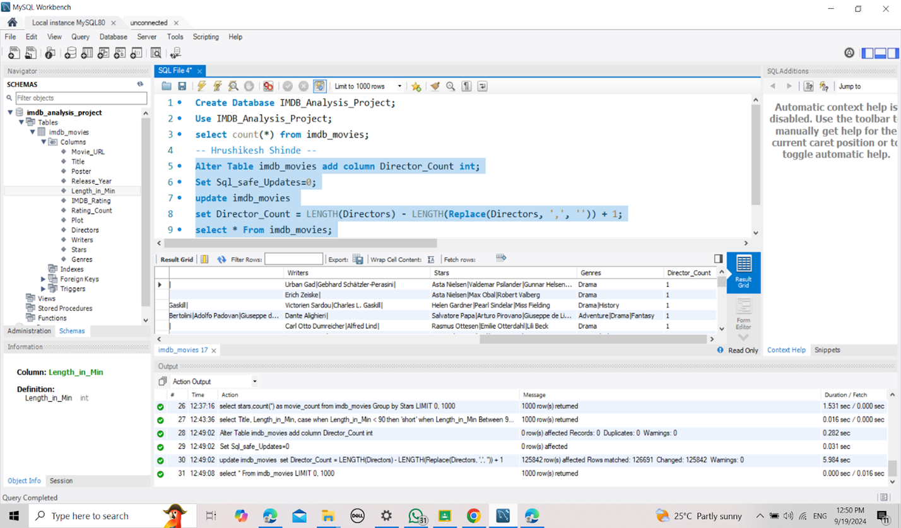
11. Add a new column director_count to the movies table that calculates the number of directors for each movie.
Solution:-Alter Table imdb_movies add column Director_Count int; Set Sql_safe_Updates=0;
updateimdb_movies
set Director_Count = LENGTH(Directors) - LENGTH(Replace(Directors, ',', '')) + 1;
select * From imdb_movies;

Slide 15
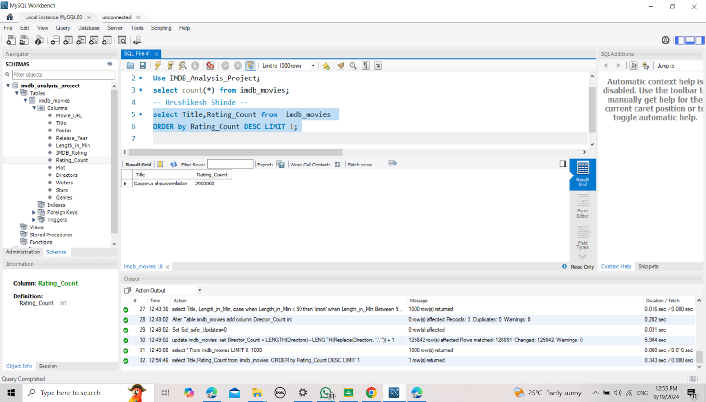
12. Using an advanced function to find the movie with the highest rating count.
Solution:-select Title,Rating_Count from imdb_movies
ORDER by Rating_Count DESC LIMIT 1;

Slide 16
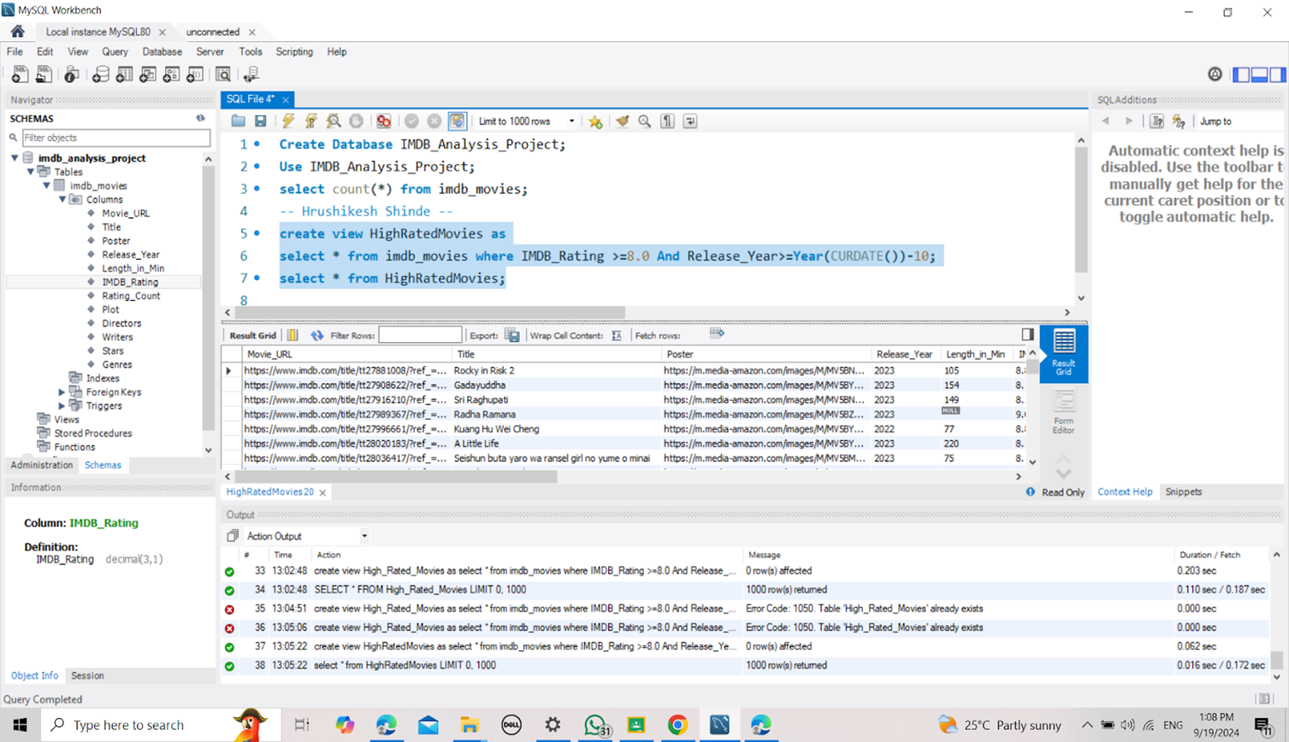
13. Using an advanced function to find the movie with the highest rating count.
Solution:- create view HighRatedMovies as
select * from imdb_movies where IMDB_Rating >=8.0 And
Release_Year>=Year(CURDATE())-10;
select * from HighRatedMovies;

Slide 17
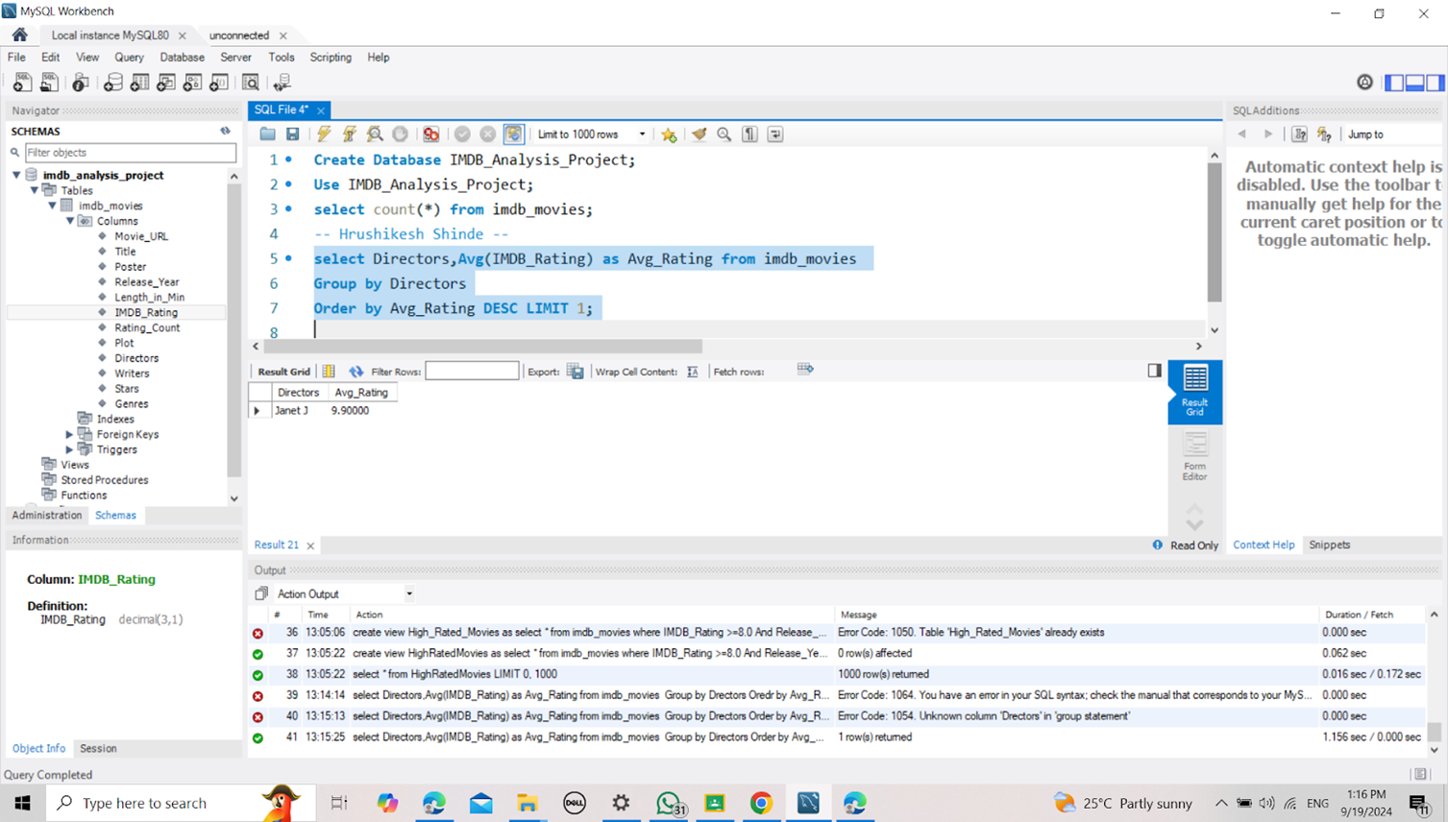
14. Find the director with the highest average IMDB rating for their movies. Use subqueries and aggregate functions to achieve this.
Solution:- select Directors,Avg(IMDB_Rating) as Avg_Rating from imdb_movies
Group by Directors
Order by Avg_Rating DESC LIMIT 1;

Slide 18
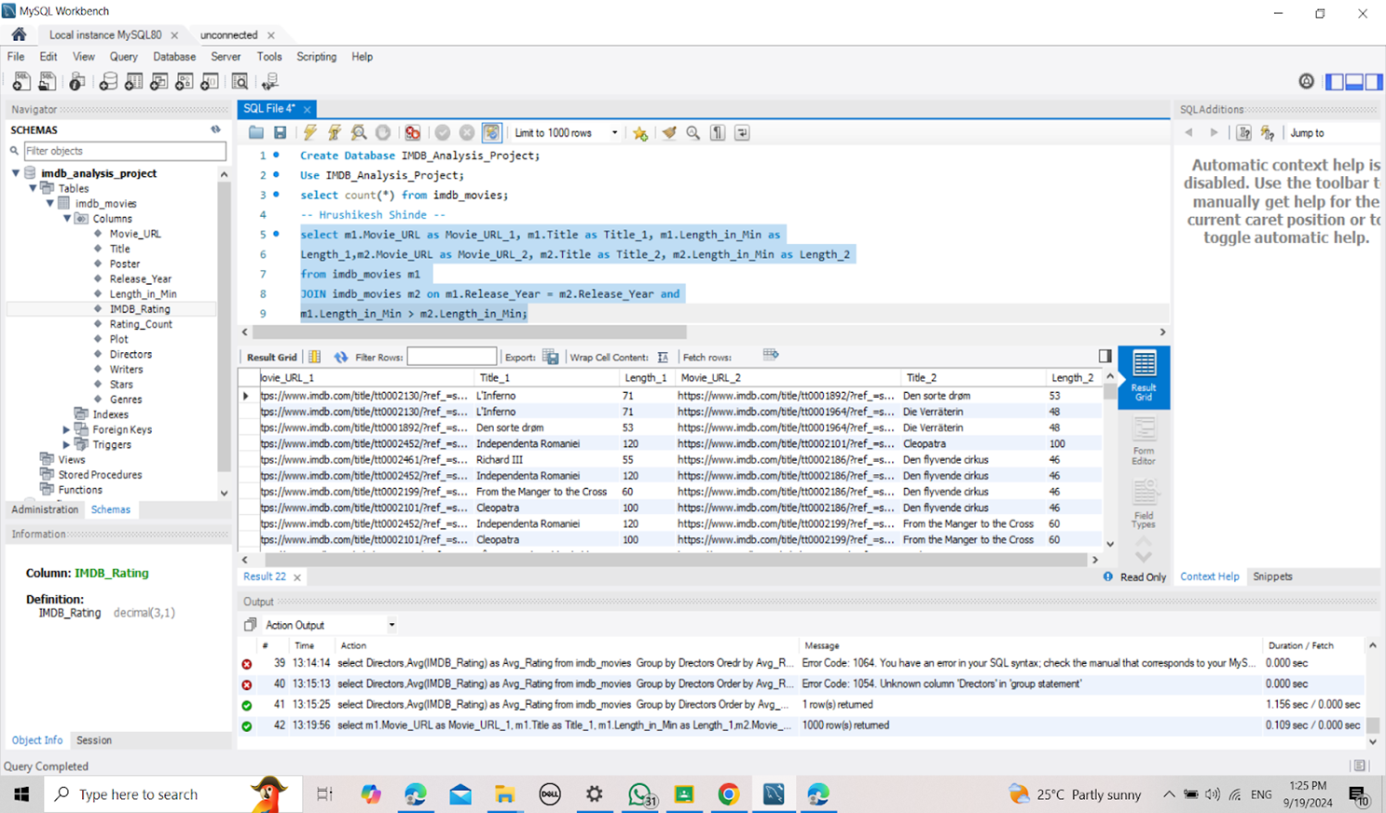
15. Find pairs of movies released in the same year where one movie has a longer duration than the other. Display columns for movie URL_1, title_1, length_1, movie URL_2, title_2, and length_2.
Solution:- select m1.Movie_URL as Movie_URL_1, m1.Title as Title_1, m1.Length_in_Min as
Length_1,m2.Movie_URL as Movie_URL_2, m2.Title as Title_2, m2.Length_in_Min as
Length_2
from imdb_movies m1
JOIN imdb_movies m2 on m1.Release_Year = m2.Release_Year and
m1.Length_in_Min > m2.Length_in_Min;

